Slide 1

DHE Learning Outcomes Assessment: Looking Backwards, Going Forward
Dr. Robert Awkward, Director of Learning Outcomes Assessment
September 28, 2018

Slide 2


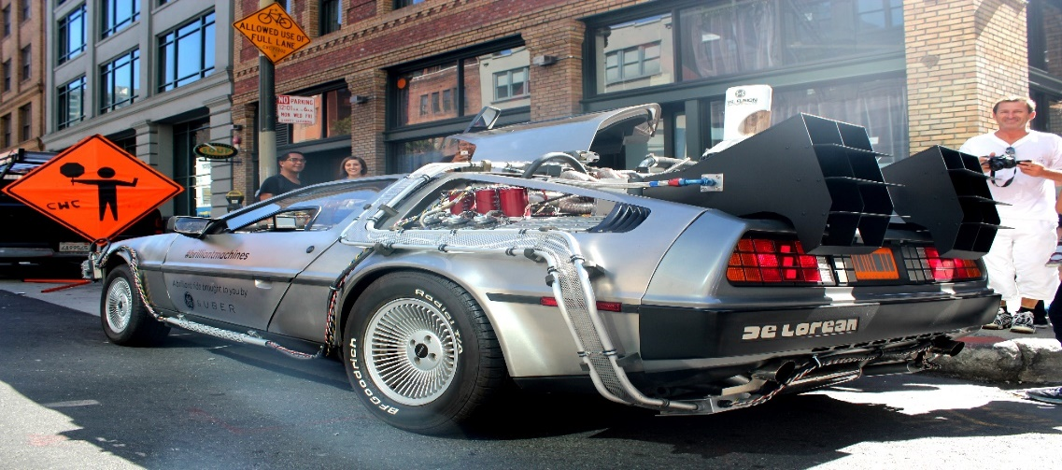

Looking Backwards, Going Forward
A Review of 2017-2018
Amcoa Team Survey Feedback
DHE Website/Student Learning Outcomes
Planning for 2018-2019
This Photo by Unknown Author is licensed under CC BY-SA

Slide 3

Looking Backwards
Amcoa Team Meetings:
  Sept. 29: Dr. Jonathan Gyurko, ACUE
  Nov. 30: Dr. Mark Nicholas, Framingham State, “Academic Program Assessment: The Nuts & Bolts”
  Feb. 2: Colleen Malloy, Portfolium
  March 29: Dr. Julie Johnson, Faculty Guild
Task Force on Statewide Assessment:
  Oct. 17: Dr. Douglas Roscoe, University of Massachusetts Dartmouth
  Jan. 18: Multi-State Collaborative (MSC) Results & The Status of the MSC
  March 9: Continuing Challenges for Assessment: A Point-Counterpoint Discussion

Slide 4
Looking Backwards: Amcoa Participant Survey
SurveyMonkey
June 2018
47% response rate
Question No. | Question | Very Satisfied | Satisfied
1 | Your experience | 28% | 53%
2 | Amcoa’s role | 54% | 34%
3 | Worcester location | 33% | 36%
4 | Meeting Time | 56% | 28%
5 | Four meetings | 46% | 49%

Slide 5
Looking Backwards: Amcoa Participant Survey
Clear preference is to learn from each other versus vendors with whom we have no money to buy
The exception was ACUE due to its relevance
Question No. | Question | Very Satisfied | Satisfied
6 | ACUE | 30% | 30%
7 | The Nuts & Bolts | 71% | 23%
8 | Portfolium | 18% | 43%
9 | Faculty Guild | 17% | 33%

Slide 6
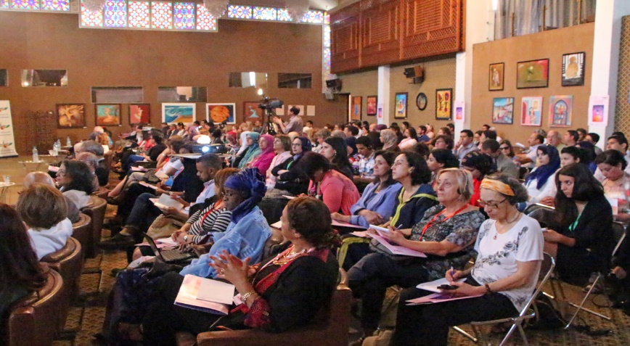
Looking Backwards
Seventh Annual Assessment Conference
“The Continuing Importance of Assessment: From Classroom to Program to Institutional levels”
Friday, April 20, 2018 @ Doubletree by Hilton, Westborough, MA
18% increase in registrants (110 to 130)
Overall conference mean score was 4.737 (94.7%)
Dr. Mary-Ann Winkelmes, UNLV; Very Satisfied = 88%
Top Breakout Sessions: Conducting Meaningful Program Assessment (Dr. Sandra O’Neil, Curry College) and Quantitative Literacy across the Curriculum (Dr. Matthew Salomon, Bridgewater State)

Slide 7
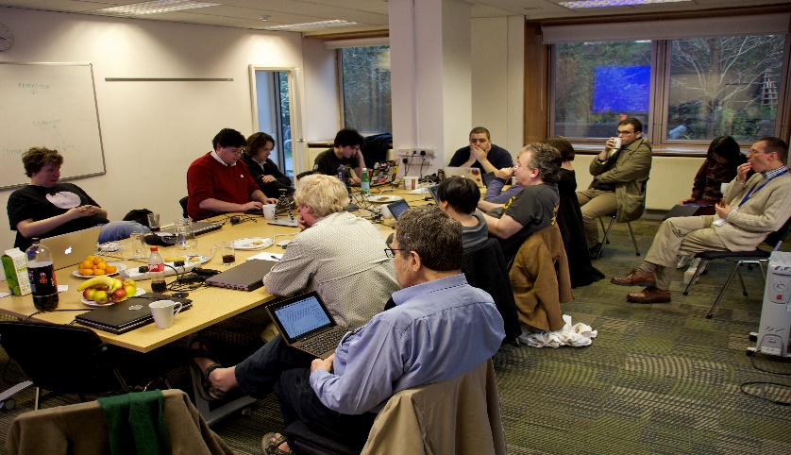
Looking Backwards
Regional Professional Development
  February 23: Central Region – “Nimbly Interpreting and Using Assessment Results to Advance All Students Toward Achieving High-Quality Program and Institutional-Level Outcomes” with Dr. Peggy Maki @QCC
  March 8: Boston Metro Region – “Academic Program Assessment” with Dr. Mark Nicholas, Framingham State @ Roxbury Community College
  May 24: Southeast Region – “Civic Learning & Assignment Design Charrette” with Dr. Elizabeth Hardwood and Dr. Ruth Slotnick, Bridgewater State @ Massachusetts Maritime Academy
  June 12: North Region – “Build Your Plan for Successful Assessment Practice” with Dr. Mark Nicholas, Framingham State @ UMass Lowell

Slide 8
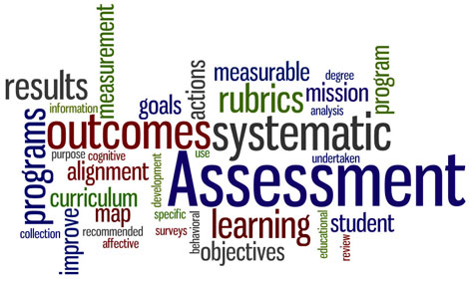
Looking Backwards
Multi-State Collaborative to VALUE Institute
  Institutional Leaders Kickoff Meeting, Sept. 8: Guest Presenter - Dr. Michael Ben-Avie, Southern Connecticut State University
  Refinement Year Results Presented (February 2018)
  Refinement Year Redux (Matched Set) Presented (March 2018)
  Areas of Focus: Critical Thinking and Quantitative Literacy
  White Paper on Assessment Approaches Developed
  Commissioner Santiago Agrees to Fund Two Years of VALUE Institute for Ten Institutions
  Selection Guidelines Developed
  Ten Institutions Selected

Slide 9
VALUE Institute Participating Institutions: 2018-2019
University of Massachusetts System
UMass Amherst
UMass Boston
State Universities
Salem State University
Community Colleges
Cape Cod Community College
UMass Lowell
Fitchburg State University
Westfield State University
Worcester State University
North Shore Community College
Northern Essex Community College
Eight out of ten categories of institutional types covered
Missing:
  High tech. institution and high minorities (i.e., STCC)
  Small institution with low minorities (e.g., Greenfield)
New participants:
  UMass Boston
  Cape Cod Community College (returning)

Slide 10

MassTransfer Pathways Student Learning Outcomes
Communication & Media Studies:
  Human Communication
  Interpersonal Communication
  Film Studies
  Media Studies
English:
  American Literature
  British Literature
  College Writing I/English Composition I
  College Writing II/English Composition II
  World Literature
History (2 of 8):
  Western Civilization I/II
Psychology (8 of 10):
  Social Psychology
  Child Development
  Abnormal Psychology
  Cognitive Psychology
  Adolescent Development
  Statistics for Psychology
  Psychology of Personality
  Brain and Behavior

Slide 11
Going Forward
Amcoa Team Meetings (all at QCC):
  Fri., Sept. 28: “Institutional Assessment Program Panel: Learning from Our Peers”
  Fri., Nov. 30: Dr. Patricia O’Brien, SND, Sr. Vice President, Commission on Institutions of Higher Education
  Fri., Feb. 1: TBD
  Fri., March 29: TBD
Task Force on Statewide Assessment (all at QCC):
  Oct. 16: Dr. James Dottin, Chair, Business Administration Department, Middlesex Community College
  Jan. 17: TBD
  March 8: TBD
Eighth Annual Assessment Conference: Place and date TBD

Slide 12

Going Forward
Regional Professional Development
Assignment Design & Rubric Alignment Charrettes
  Objectives: Improve student learning, links learning & teaching with assessment, better data, and equity
  Expected Outcomes: Increase participation in VALUE Institute, create more effective assignments, and employ the use of TILT design
  Targeted to faculty
  Incentives for attendance: Hands-on session using their own assignment, held on Friday, travel expense reimbursed, textbook on assignment design, and food
  Regionally located, i.e., West (Westfield State), Central (Worcester State), North (North Shore Community), Boston Metro (UMass Boston), and Southeast (TBD)
  Fall 2018; 9am-12Noon
  Use local assessment leaders as faculty

Slide 13

Going Forward
Regional Professional Development
Quantitative Literacy Workshops
  Objectives: Addresses area of focus from Refinement Year MSC, improve student learning, expands the use of quantitative literacy across the curriculum, links learning & teaching with assessment, better data, and equity
  Expected Outcomes: Create more effective assignments, employ the use of TILT design, and illustrate student utilization of quantitative literacy
  Targeted to cross-discipline faculty
  Incentives for attendance: Hands-on session using their own assignment, held on Friday, travel expense reimbursed, textbook on quantitative literacy, and food
  Regionally located, i.e., West, Central, North, Boston Metro, and Southeast (Bridgewater State)
  Support the SEQuel Conference at Bridgewater State
  Spring 2019
  Host guest speakers and showcase local faculty

Slide 14

Going Forward
Assessment Program Design One Day Workshop for Institutional Teams
  Place (centrally located) and date TBD (Friday)
  Focus will be on institutional teams of up to five to develop or strengthen their assessment program
  Facilitator: Dr. Mark Nicholas, Executive Director of Institutional Assessment, Framingham State University
  Food and refreshments to be provided

Slide 15
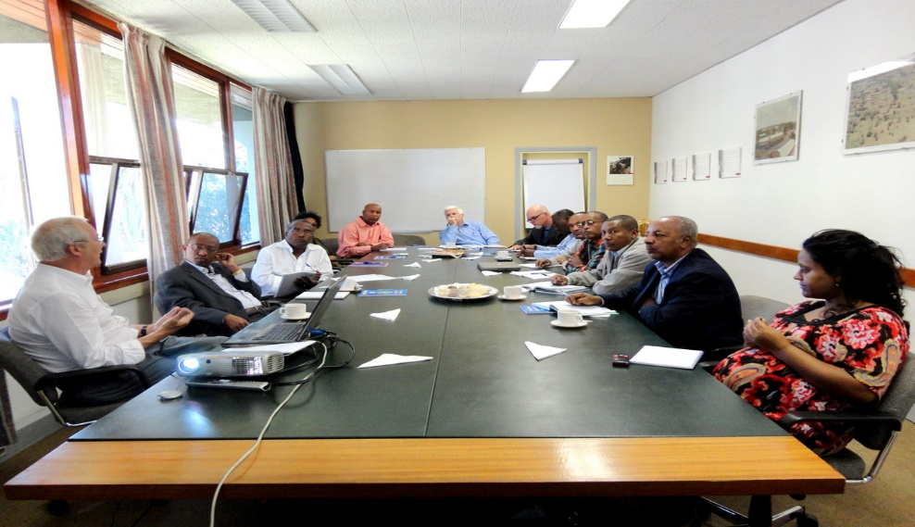
Looking Backwards
VALUE Institute
  Institutional Leaders Kickoff Meeting, Sept. 14: Guest Presenter - Dr. Brian Doore, Unity College; formerly Director of Assessment, University of Maine
  Area of Focus: Critical Thinking for 2018-2019, and 2019-2020
  Continue Participation in the MSC National Steering Committee; MSC will be a sub-group within VALUE Institute
  Data Analysis, Presentation, and Reporting by Two-Year and Four-Year Institutions

Slide 16

MassTransfer Pathways Student Learning Outcomes
Carryover from AY 2018
Business Administration
Criminal Justice
Early Childhood Education
New for AY 2019
Elementary Education
Engineering
Fine Arts & Graphics
Math

Slide 17

Going Forward
Open Educational Resources (OER) Working Group
  Invite team members to the Working Group
  Convene the Working Group
  Conduct research
  Develop an OER statewide policy and implementation plans
  Gain approval of the statewide policy from the Board of Higher Education
  Effect the policy and implementation plans

Slide 18
Questions…Comments?
Thank You!!

